Slide 1


Slide 2
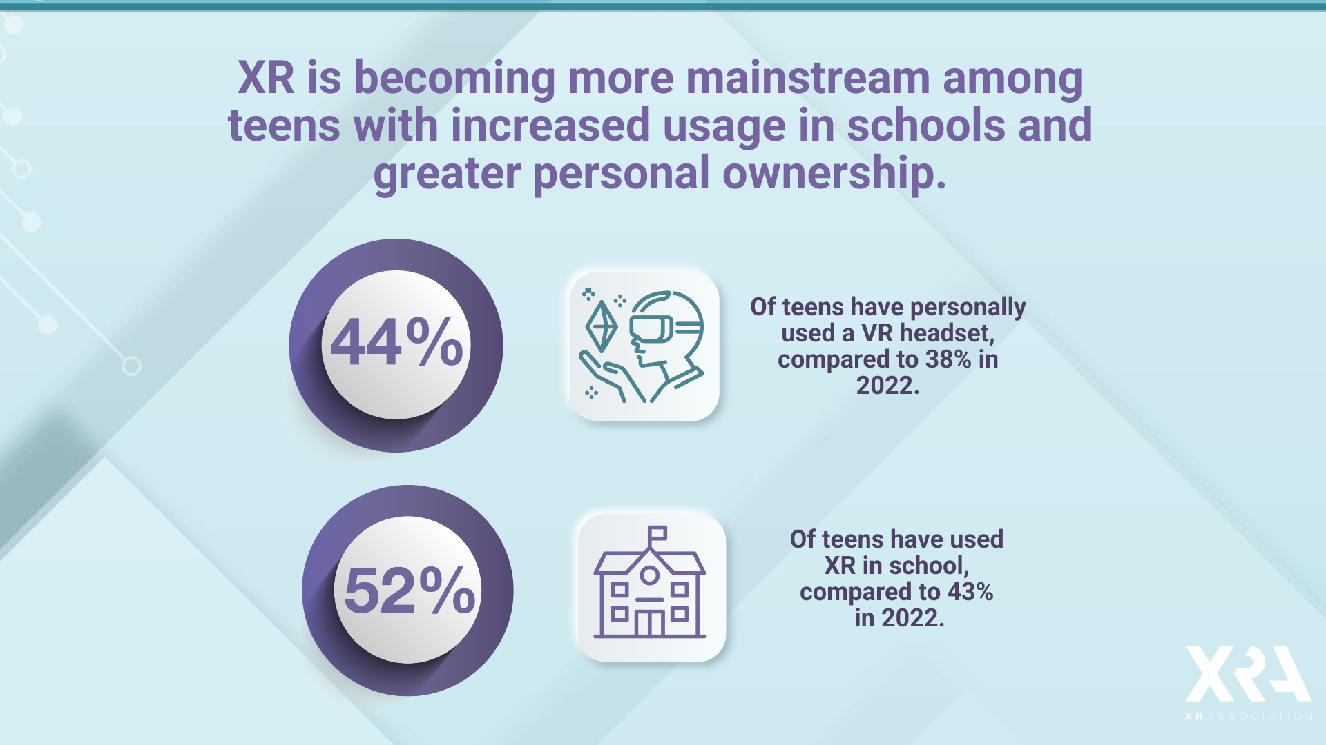

Slide 3
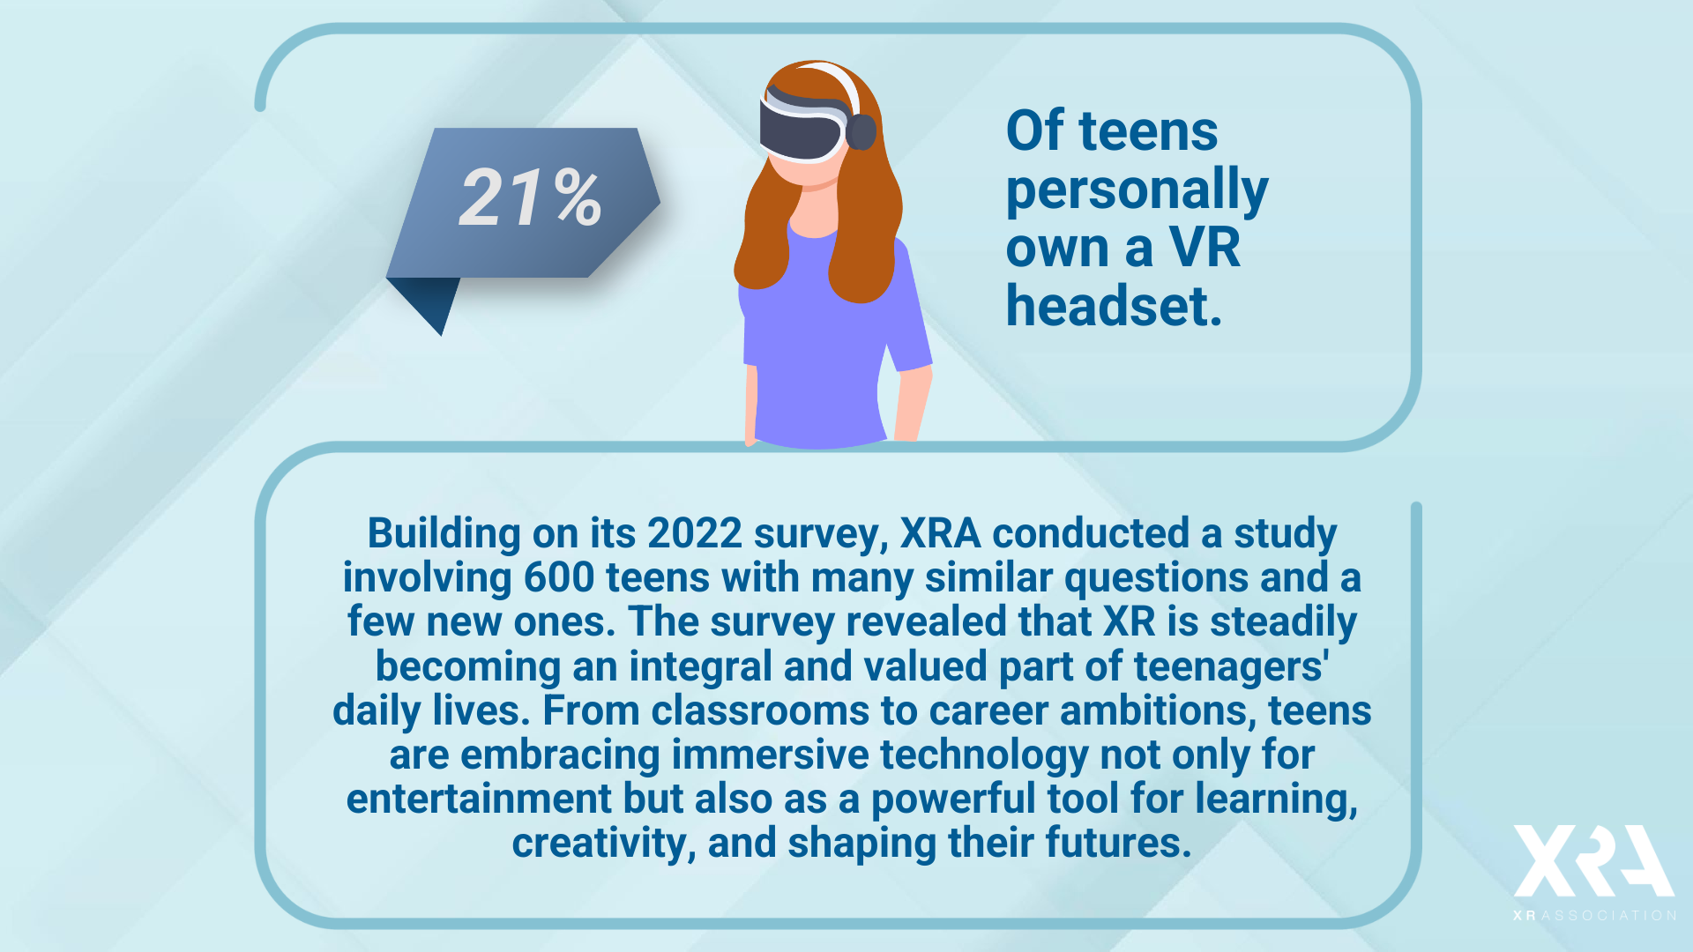

Slide 4


Slide 5


Slide 6


Slide 7
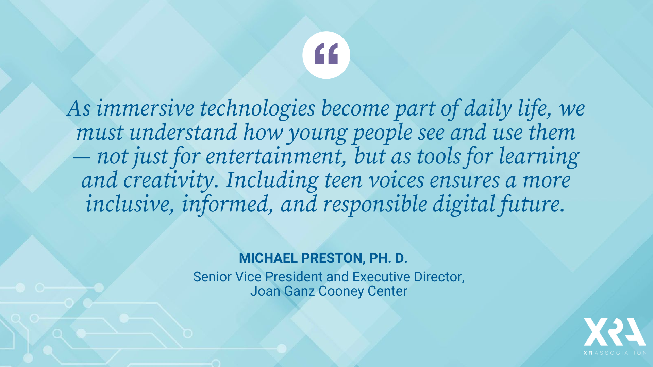

Slide 8
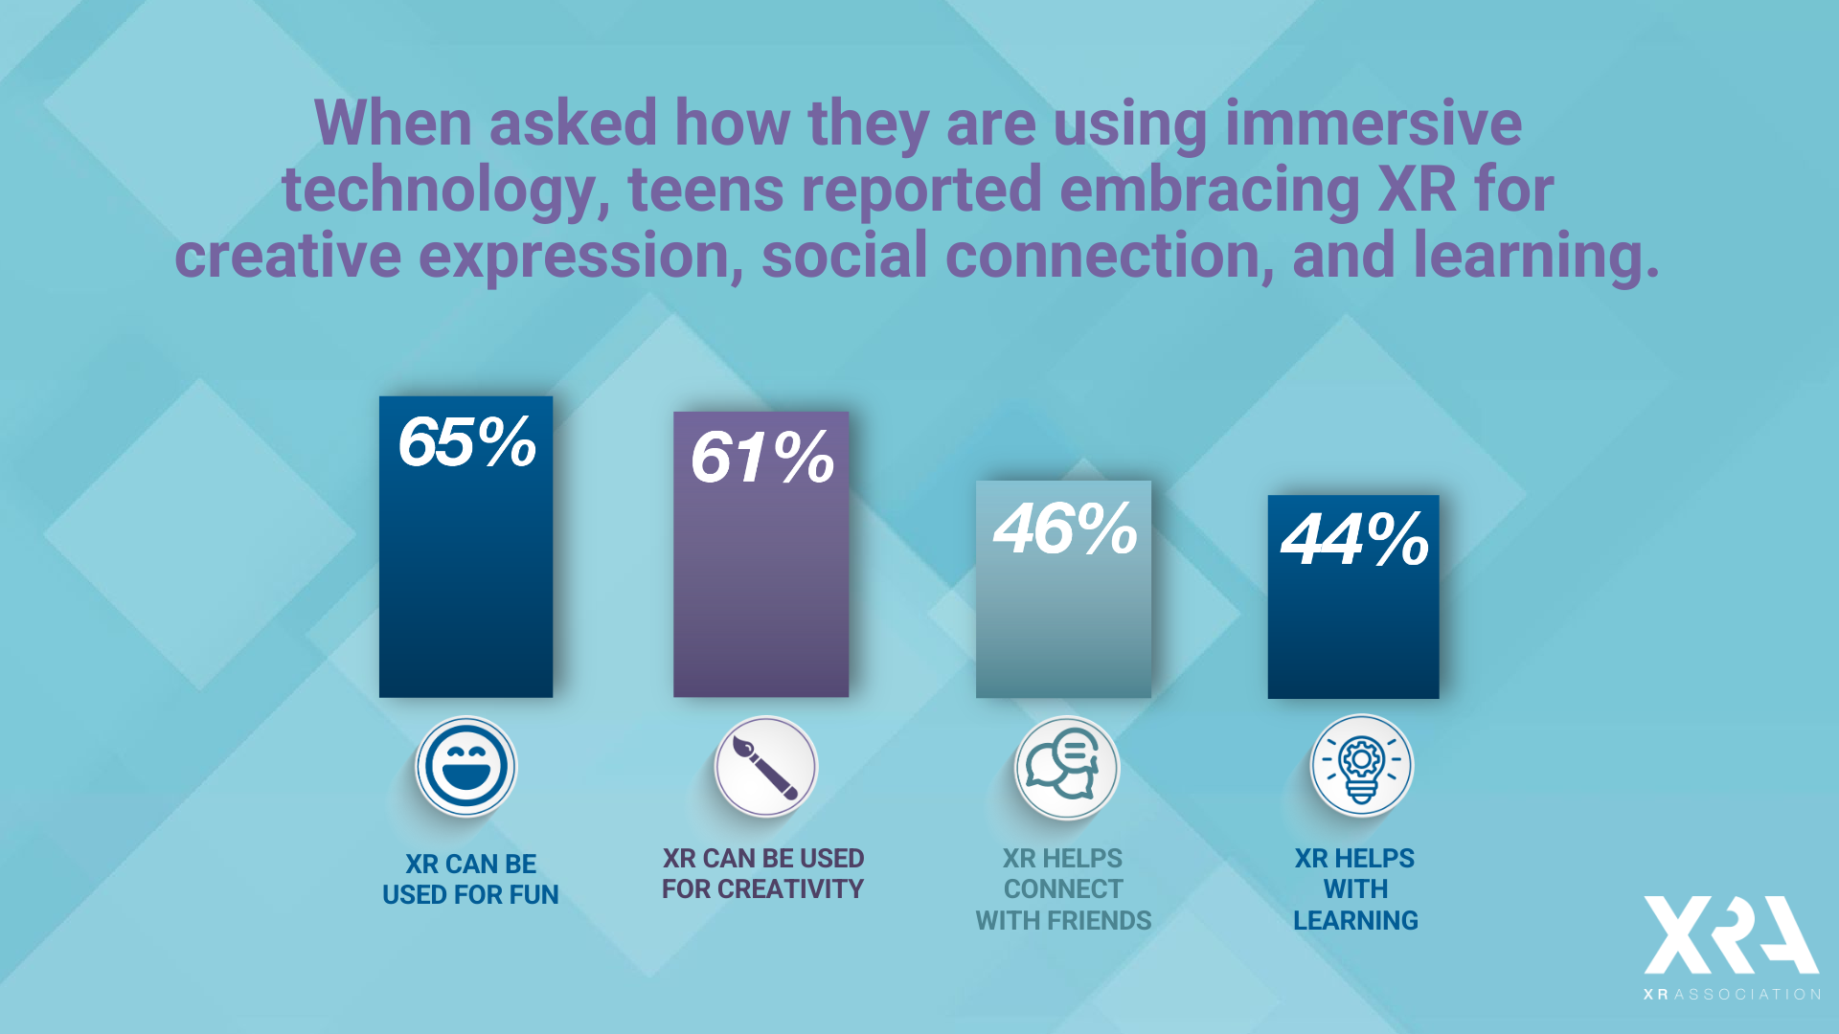

Slide 9
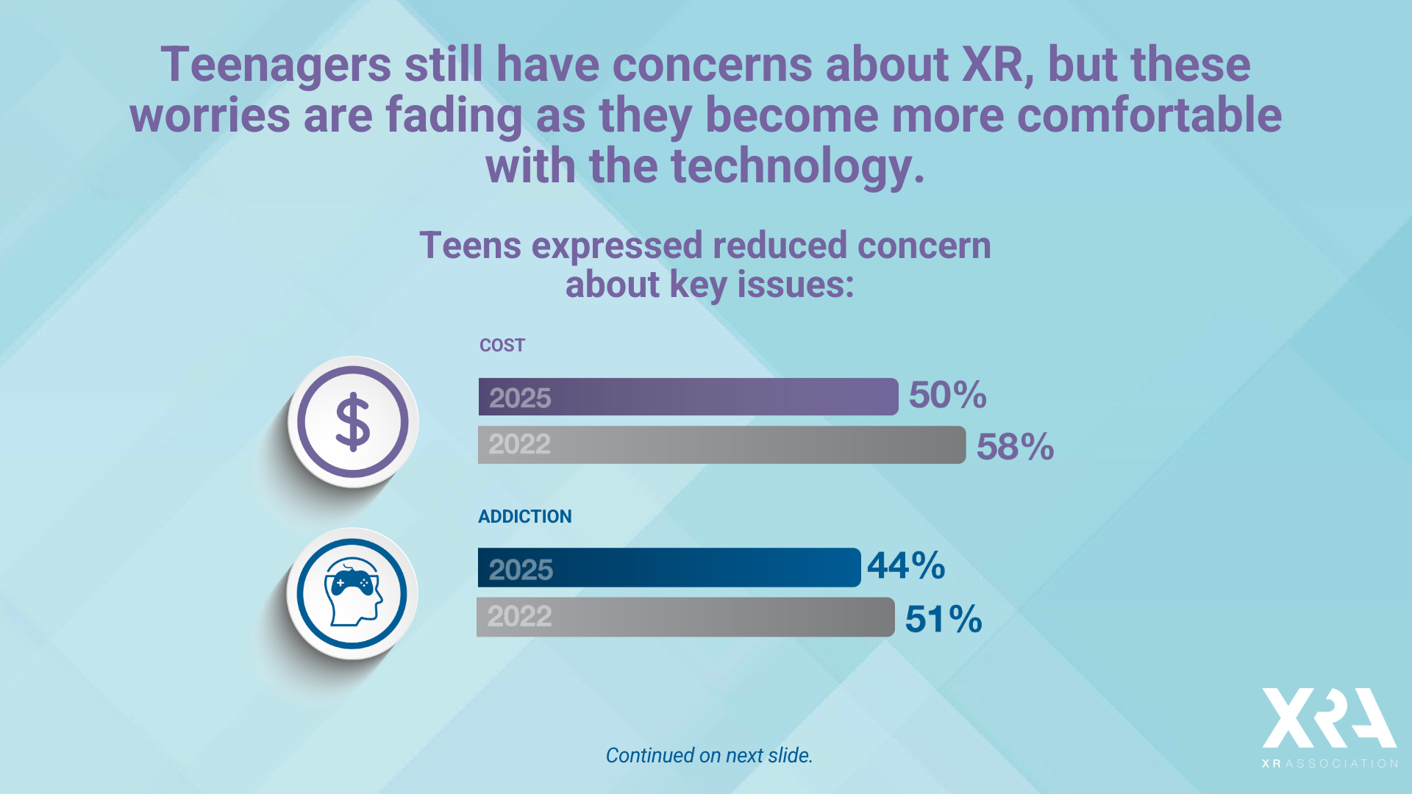

Slide 10
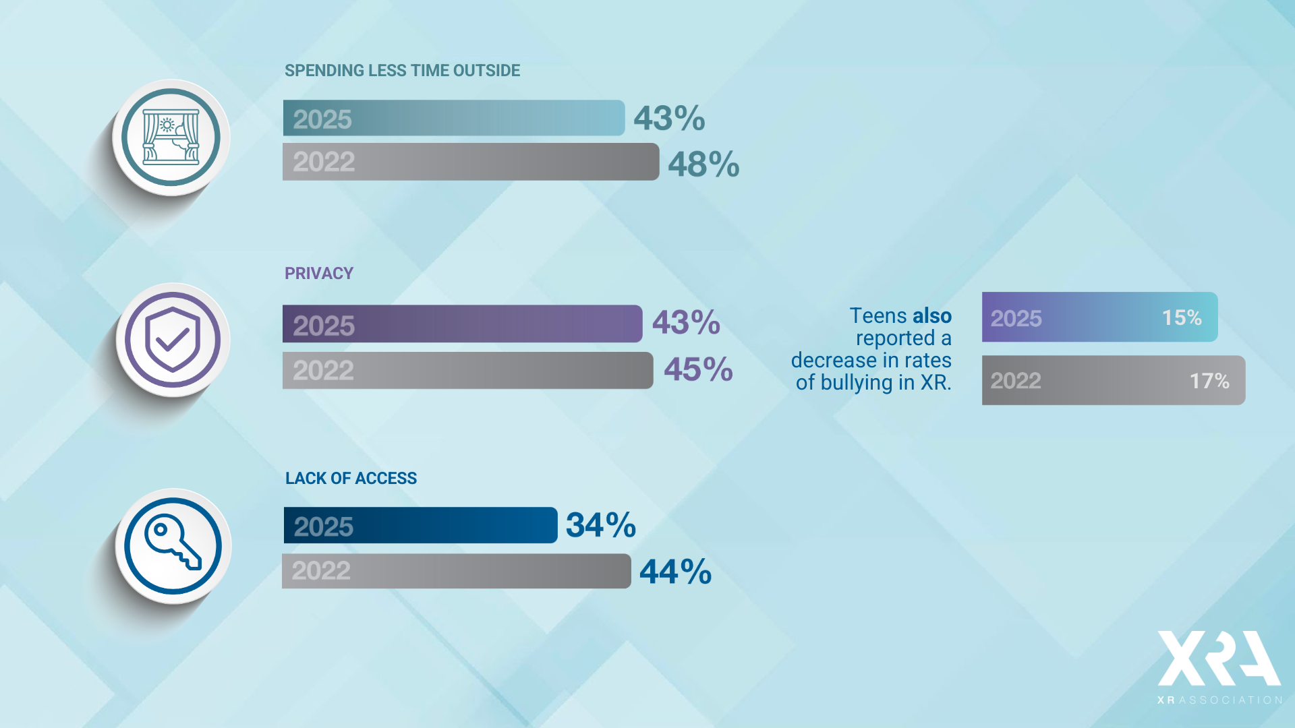

Slide 11


Slide 12


Slide 13
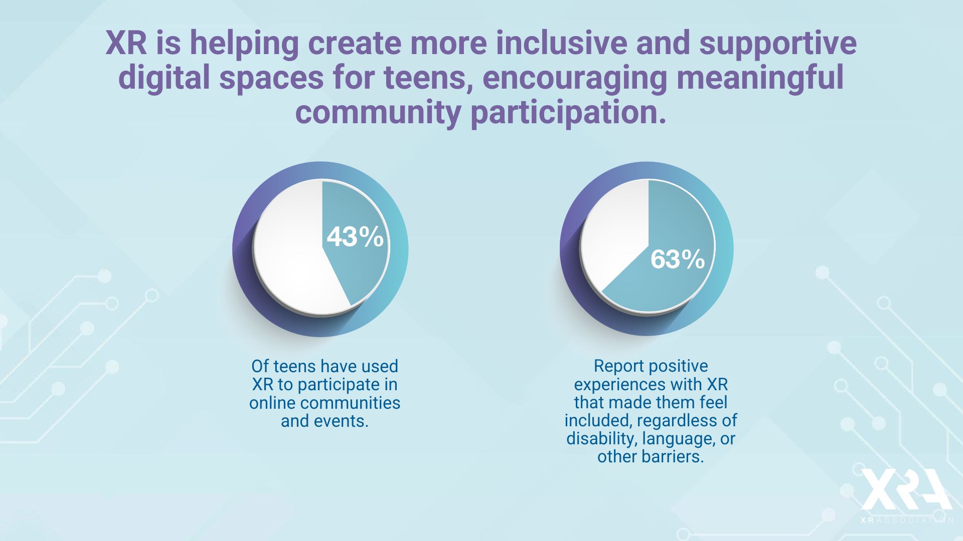

Slide 14




To learn more about how XR technology can support and enhance education, download XRA’s Developer’s Guides.
If you are interested in participating in shaping these initiatives, become a member and join the XRA Health and Inclusion Committee.
The XR Association's mission is to promote the responsible development and thoughtful advancement of XR that foster positive societal outcomes. Find out more about us at xra.org.

